Slide 1
Analysis of Financial Statements
Project – phase II
Compiled by Dr Maha Ramadan
Copyright ©2021 McGraw-Hill Education. All rights reserved. No reproduction or distribution without the prior written consent of McGraw-Hill Education.

Slide 2
Purpose of Analysis
Common goal of financial statement analysis for both external and internal users is to evaluate company performance and financial condition and to assist in evaluating:
Past and current performance
Current financial position
Future performance and risk
Internal Users Managers Officers
Internal Auditors
External Users Shareholders Lenders Suppliers
Learning Objective C1: Define the building blocks of analysis and the standards for comparisons.
Notes:
Financial statement analysis applies analytical tools to financial statements and related data for making business decisions.
Internal users of accounting information manage and operate the company. They include managers, officers, and internal auditors. The purpose of financial statement analysis for internal users is to provide information to improve efficiency and effectiveness in providing products and services.
External users of accounting information are not directly involved in running the company. They include shareholders, lenders, and suppliers. External users use financial statement analysis to make more informed decisions to pursue their own goals.
The common goal of these users is to evaluate company performance and financial condition. This includes evaluating (1) past and current performance, (2) current financial position, and (3) future performance and risk.

Slide 3
Building Blocks of Analysis
Liquidity and efficiency
Solvency
Profitability
Market prospects
Learning Objective C1: Define the building blocks of analysis and the standards for comparisons.
Notes:
Financial statement analysis focuses on one or more elements of the four areas that are the building blocks of financial statement analysis:
Liquidity and efficiency—ability to meet short-term obligations and to efficiently generate revenues.
Solvency—ability to generate future revenues and meet long-term obligations.
Profitability—ability to provide financial rewards sufficient to attract and retain financing.
Market prospects—ability to generate positive market expectations.

Slide 4
Standards for Comparison
When we interpret our analysis, it is essential to compare the results we obtained to other standards or benchmarks.
Intracompany
Competitor
Industry
Guidelines
Learning Objective C1: Define the building blocks of analysis and the standards for comparisons.
Notes:
When analyzing financial statements, we use the following standards (benchmarks) for comparison:
Intracompany—The company’s current performance is compared to its prior performance and its relations between financial items. Apple’s current net income, for instance, can be compared with its prior years’ net income and in relation to its revenues or total assets.
Competitor—Competitors provide standards for comparisons. Coca-Cola’s profit margin can be compared with PepsiCo’s profit margin.
Industry—Industry statistics provide standards of comparisons. Intel’s profit margin can be compared with its industry’s profit margin.
Guidelines (rules of thumb)—Standards of comparisons can develop from experience. Examples are the 2:1 level for the current ratio or 1:1 level for the acid-test ratio.
Benchmarks from a competitor or group of competitors are often best. Intracompany and industry measures are also important. Guidelines or rules of thumb should be applied with care, and then only if they seem reasonable given past experience and industry norms.

Slide 5
Financial Ratio Analysis
Financial ratio analysis is the use of relationships among financial statement accounts to gauge the financial condition and performance of a company.
We can classify ratios based on the type of information the ratio provides:
Activity Ratios
Effectiveness in putting its asset investment to use.
Liquidity Ratios
Ability to meet short-term, immediate obligations.
Solvency Ratios
Ability to satisfy debt obligations.
Profitability Ratios
Ability to manage expenses to produce profits from sales.
Notes:
LOS: Calculate and interpret measures of a company’s operating efficiency, internal liquidity (liquidity ratios), solvency, and profitability, and demonstrate the use of these measures in company analysis.
Pages 356–357
3. Financial Ratio Analysis
Classifying ratios:
Activity ratios
Effectiveness in putting asset investment to use.
Liquidity ratios
Ability to meet short-term, immediate obligations.
Solvency ratios
Ability to satisfy debt obligations.
Profitability ratios
Ability to manage expenses to produce profits from sales.

Slide 6
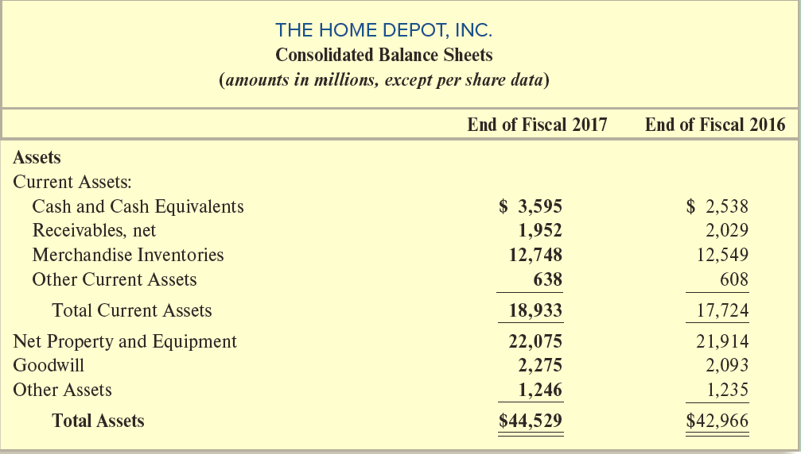
The Home Depot Financial Statements (1 of 2)
Notes:
On
this slide, you see the assets section of The Home Depot’s balance sheets for both fiscal 2017 and 2016. This information will be used to calculate the ratios on the following slides.
Average A/ Receivable= (1952+2029)/2 = 1990.5
Receivables TO= 100904/1990.5= 50.69
365/50.69=7.2 days
Cogs=66548
Average inventory = (12748+12549)/2=12648.5
Inventory To= 66548/12648.5= 5.26 365/5.26= 69.39 days operating cycle = 69.39+7.2=76.59

Slide 7
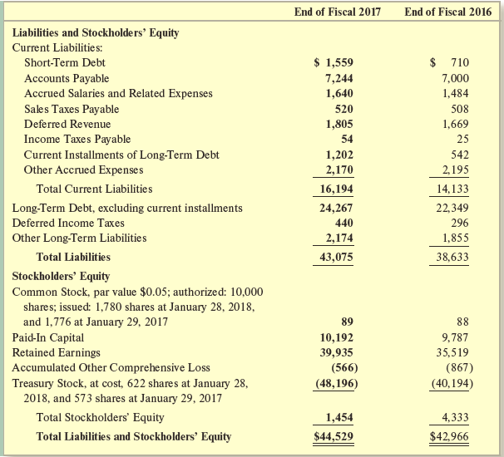
The Home Depot Financial Statements (2 of 2)
Notes:
On this slide, you see the liabilities and stockholders’ equity sections of The Home Depot’s balance sheets for both fiscal 2017 and 2016. This information will be used to calculate the ratios on the following slides.

Slide 8
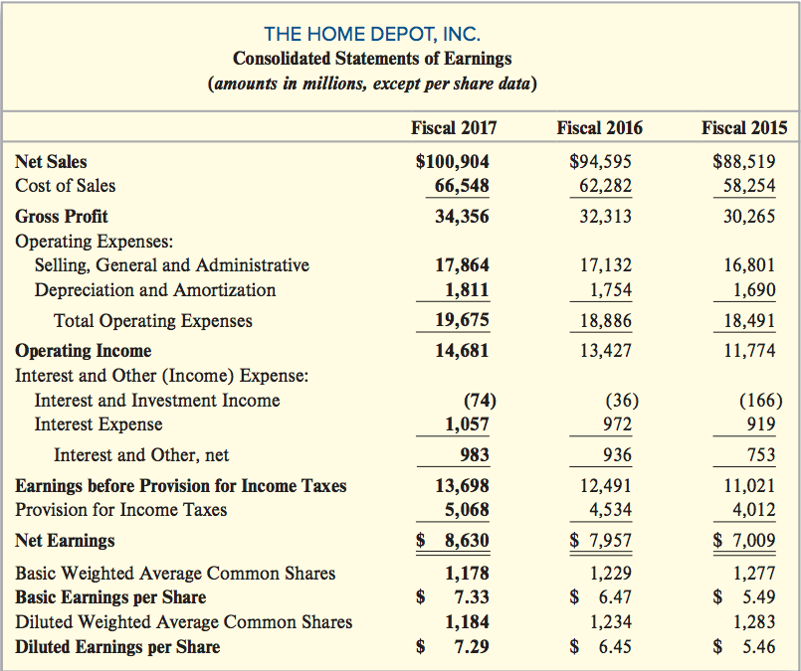
The Home Depot Financial Statements
Notes:
First, we will look at Fiscal 2017. We will set net sales to 100 percent and express all other line items on the income statement as a percentage of net sales.
Component percentages are a type of ratio. Ratios simply express one number relative to another number. With component percentages, both the numerator and the denominator of the ratio come from the same financial statement, either the income statement or the balance sheet.

Slide 9
Liquidity and Working Capital
Basics
• Liquidity - Ability to convert assets into cash or to obtain cash to meet short-term obligations.
• Short-term - Conventionally viewed as a period up to one year.
• Working Capital - The excess of current assets over current liabilities.

Slide 10
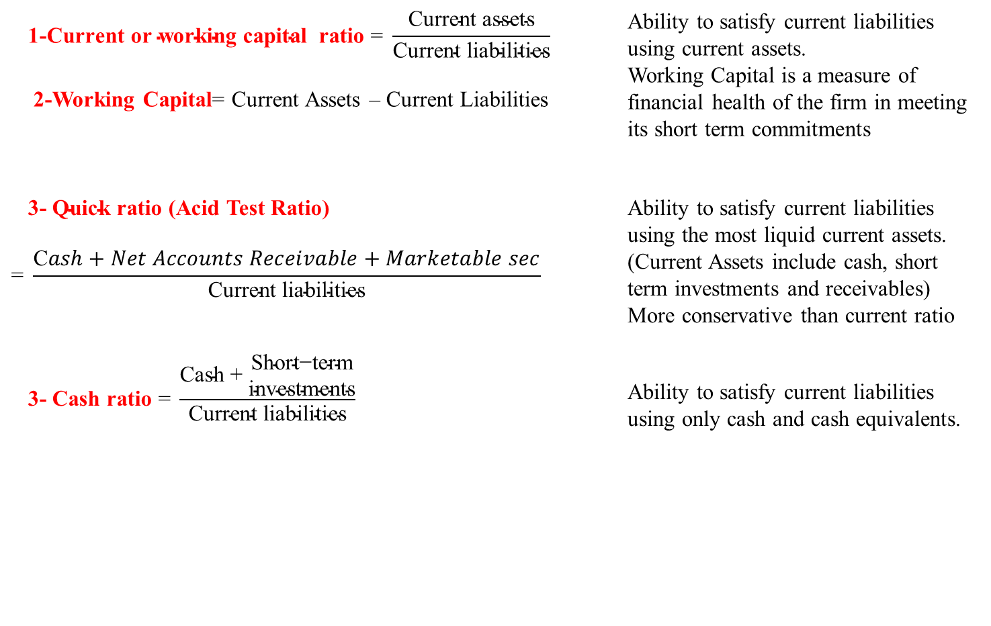
First: Liquidity Analysis
Liquidity is the ability to satisfy the company’s short-term obligations using assets that can be most readily converted into cash.
$$\text{ 1−}\text{Current} \text{or} \text{working} \text{capital} \text{ratio}\text{ = }\frac{\text{Current} \text{assets}}{\text{Current} \text{liabilities}}$$ 2-Working Capital= Current Assets – Current Liabilities |  | Ability to satisfy current liabilities using current assets. Working Capital is a measure of financial health of the firm in meeting its short term commitments
$\text{ 3− }\text{Quick} \text{ratio}$ (Acid Test Ratio) $$\text{= }\frac{\text{C}ash+Net Accounts Receivable+Marketable sec}{\text{Current} \text{liabilities}}$$ |  | Ability to satisfy current liabilities using the most liquid current assets. (Current Assets include cash, short term investments and receivables) More conservative than current ratio
$$\text{ 3− }\text{Cash} \text{ratio}\text{ = }\frac{\text{Cash}\text{ + }\begin{matrix}\text{S}\text{hort}\text{−}\text{term} \\ \text{investments}\end{matrix}}{\text{Current} \text{liabilities}}$$ |  | Ability to satisfy current liabilities using only cash and cash equivalents.
Notes:
LOS: Calculate and interpret measures of a company’s operating efficiency, internal liquidity (liquidity ratios), solvency, and profitability, and demonstrate the use of these measures in company analysis.
Pages 363–365
Liquidity
Liquidity is the ability to satisfy the company’s short-term obligations using assets that can be most readily converted into cash.
Liquidity ratios:
Current ratio: Ability to satisfy current liabilities using current assets.
Quick ratio: Ability to satisfy current liabilities using the most liquid of current assets.
Cash ratio: Ability to satisfy current liabilities using only cash and cash equivalents.

Slide 11
Current Ratio
This ratio measures the ability of the company to pay current debts as they become due.
Current
Ratio
Current Assets
Current Liabilities
=
The Home
Depot 2017
$18,933
$16,194
=
=
1.17
A ratio greater than 1 implies that a company’s current assets are sufficient to cover its current liabilities. If a company’s current ratio is less than 1, analysts will want to understand how the company intends to meet its short-term obligations. At the end of fiscal 2017, The Home Depot had $1.17 in current assets for each $1.00 in current liabilities.
Notes:
The current ratio measures to what extent a company’s total current assets cover its total current liabilities on a specific date. A ratio greater than 1 implies that a company’s current assets are sufficient to cover its current liabilities. If a company’s current ratio is less than 1, analysts will want to understand how the company intends to meet its short-term obligations.
The optimal level of the current ratio depends on the business environment in which a company operates. If cash flows are predictable and stable, the current ratio can be low, even less than 1. When cash flows are highly variable, a higher current ratio is desirable.
Analysts become concerned if a company’s current ratio is high compared to that of other companies in its industry. A firm is operating inefficiently when it ties up too much money in inventory or accounts receivable. It is also important to keep in mind that current assets other than cash need to be converted to cash before they can be used to satisfy current obligations.

Slide 12
Quick Ratio
This ratio is a more stringent test of short-term liquidity than the current ratio.
Quick
Ratio
Quick Assets
Current Liabilities
=
The Home
Depot 2017
($3,595 + $1,952 + $0)
$16,194
=
0.34
=
Quick assets are defined as cash and near-cash assets (net accounts receivable and marketable securities). Inventory and Prepaid expenses are omitted from quick assets. At the end of fiscal 2017, The Home Depot has 34 cents in cash and near-cash assets for every $1.00 in current liabilities.
Notes:
The quick ratio, sometimes referred to as the acid test, is a more stringent test of short-term liquidity than is the current ratio. The quick ratio compares quick assets, defined as cash and near-cash assets, to current liabilities. Quick assets include cash, net accounts receivable, and marketable securities. Inventory is omitted from quick assets because of the uncertainty of the timing of cash flows from its sale. Prepaid expenses also are excluded from quick assets.
The quick ratio is a measure of whether the highly liquid assets of a company, those that can be converted to cash quickly, are sufficient to cover current liabilities. The Home Depot has 34 cents in cash and near-cash assets for every $1.00 in current liabilities. This margin of safety is typical of the retail industry and would be considered a sufficient margin in light of the large amount of cash The Home Depot generates from its operating activities.

Slide 13
Cash Ratio
This ratio measures the adequacy of available cash.
Cash
Ratio
Cash & Cash Equivalents
Current Liabilities
=
The Home
Depot 2017
$3,595
$16,194
=
=
0.22
At the end of fiscal 2017, The Home Depot has 22 cents of cash for each $1.00 of current liabilities.
Notes:
Cash is the lifeblood of a business. Without cash, a company cannot pay its employees or meet its obligations to creditors. Even a profitable business will fail without sufficient cash.
In fiscal 2017, The Home Depot’s cash ratio was 0.22. The Home Depot’s cash ratio indicates that the company has on hand 22 cents of cash for each $1.00 of current liabilities. Would analysts be concerned about this number? Not likely. It is important to keep in mind that not all of The Home Depot’s current liabilities need to be paid immediately. It therefore does not need to keep enough cash on hand at any point in time to cover all of its short-term obligations. As mentioned previously, The Home Depot’s statement of cash flows shows that the company generated $12.0 billion in cash from its operating activities in fiscal 2017. As a result, it is highly likely that The Home Depot will have sufficient cash on hand when the time comes to meet any given current liability. Many analysts believe the cash ratio should not be too high because holding excessive amounts of cash implies that the company is not investing the cash in more productive assets to grow the business.

Slide 14
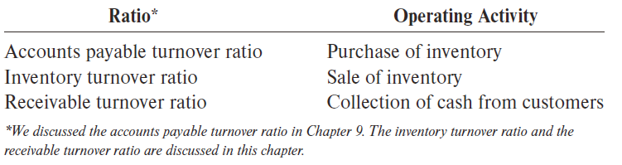
Second: Operating Cycle (Activity) Ratios
The operating cycle is the time it takes for a company to pay cash to its suppliers, sell goods to its customers, and collect cash from its customers. Analysts are interested in the operating cycle because it helps them evaluate a company’s cash needs and is a good indicator of operating efficiency.
The operating cycle for most companies involves three distinct phases:
the acquisition of inventory
the sale of the inventory
the collection of cash from the customer.
Several ratios are helpful when evaluating a company’s operating cycle:
Notes:
Each of the ratios measures the number of days it takes, on average, to complete an operating activity. Examining each phase of the operating cycle helps us understand the cash needs of the company.
Companies prefer to minimize the time between paying vendors and collecting cash from customers because it frees up cash for other productive purposes. Companies could reduce this time by slowing payments to creditors or by increasing how quickly it turns over its inventory.

Slide 15
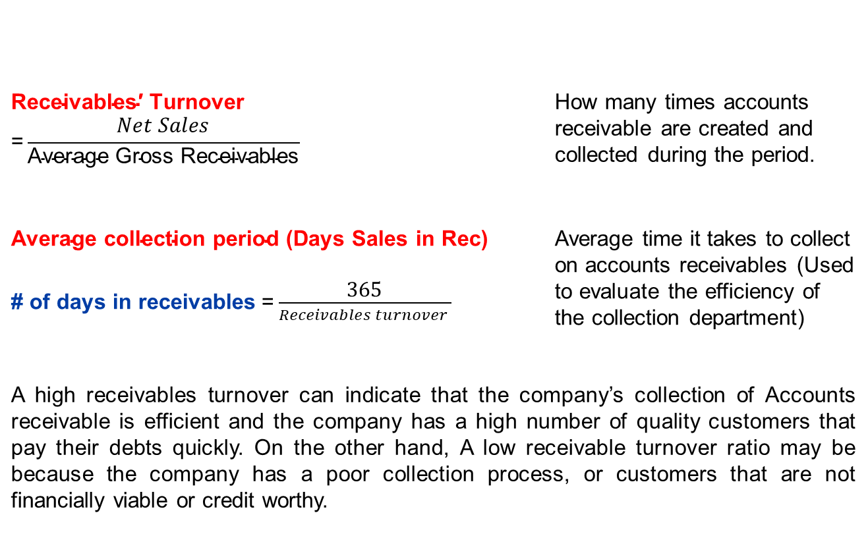
Accounts Receivable Turnover Ratio
$$\text{Receivables}\text{′ }\text{Turnover}\text{ =}\frac{Net Sales}{\text{Average} \text{Gross} \text{Receivables}}$$ | How many times accounts receivable are created and collected during the period.
$\text{Average} \text{collection} \text{period}$ (Days Sales in Rec) # of days in receivables$\text{=}\frac{\text{365}}{Receivables turnover }$ | Average time it takes to collect on accounts receivables (Used to evaluate the efficiency of the collection department)
A high receivables turnover can indicate that the company’s collection of Accounts receivable is efficient and the company has a high number of quality customers that pay their debts quickly. On the other hand, A low receivable turnover ratio may be because the company has a poor collection process, or customers that are not financially viable or credit worthy.
Notes:
LOS: Calculate and interpret measures of a company’s operating efficiency, internal liquidity (liquidity ratios), solvency, and profitability, and demonstrate the use of these measures in company analysis.
Pages 358–360
Activity Ratios
Turnover ratios reflect the number of times assets flow into and out of the company during the period.
A turnover is a gauge of the efficiency of putting assets to work.
Inventory turnover: How many times inventory is created and sold during the period.
Receivables turnover: How many times accounts receivable are created and collected during the period.
Total asset turnover: The extent to which total assets create revenues during the period.
Working capital turnover: The efficiency of putting working capital to work.
Note: A way of looking at turnover ratios is to consider that the denominator is the investment that is being put to work and the numerator is the result of that effort.

Slide 16
Receivable Turnover Ratio
This ratio measures how quickly a company collects its accounts receivable.
Receivable Turnover Ratio
Net Credit Sales¹
Average Net Receivables
=
The Home
Depot 2017
$100,904
$1,991*
=
= 50.69 times
*($2,029 + $1,952)
2
= $1,991
A high receivable turnover ratio suggests that a company collects its accounts receivable many times during a year. On average, The Home Depot collects its accounts receivable over 50 times a year.
¹If credit sales are not reported separately, use total net sales as an approximation
Notes:
Being able to efficiently collect accounts receivable is critical to a company. Analysts know this and therefore keep close watch on a company’s receivable turnover ratio.
A high receivable turnover ratio suggests that a company collects its accounts receivable many times during a year. The Home Depot, on average, collects its accounts receivable over 50 times a year. Granting credit to customers with poor credit and ineffective collection efforts will produce a low receivable turnover ratio. While a very low ratio is obviously a problem, a very high ratio also can be troublesome because it suggests an overly stringent credit policy that could cause lost sales and profits.

Slide 17
Receivable Turnover Ratio – Converted to Days
The receivable turnover ratio often is converted to reflect the number of days, on average, it takes a company to collect its
Average Days to Collect Receivables
Days in a Year
Receivable Turnover Ratio
=
The Home
Depot 2017
365
50.69
=
= 7.20 days
The Home Depot’s average days to collect receivables ratio implies that it takes the company an average of just over seven days to collect its accounts receivable.
Notes:
The receivable turnover ratio often is converted to reflect the number of days, on average, it takes a company to collect its receivables.
The Home Depot’s average days to collect receivables ratio implies that it takes the company an average of just over seven days to collect its accounts receivable. Although the receivable turnover ratio normally provides useful insights, the one for The Home Depot is not meaningful. It is highly unlikely that The Home Depot collects cash from its credit customers in just seven days. Because we did not know the amount of The Home Depot’s credit sales, we used total sales as an approximation. In this case, the approximation is not reasonable. Most customers use a bank credit card such as MasterCard or Visa. From The Home Depot’s perspective, a sales transaction involving a bank credit card is recorded as a cash sale because the credit card company quickly transfers cash to The Home Depot and then takes on the responsibility of collecting from the customer. As a result, many of The Home Depot’s sales are actually cash sales, invalidating the assumption that total sales are a reasonable proxy for credit sales. This situation illustrates that ratio analysis involves more than the mere computation of numbers. Analysts must evaluate the results based on their understanding of a company’s business strategy.

Slide 18
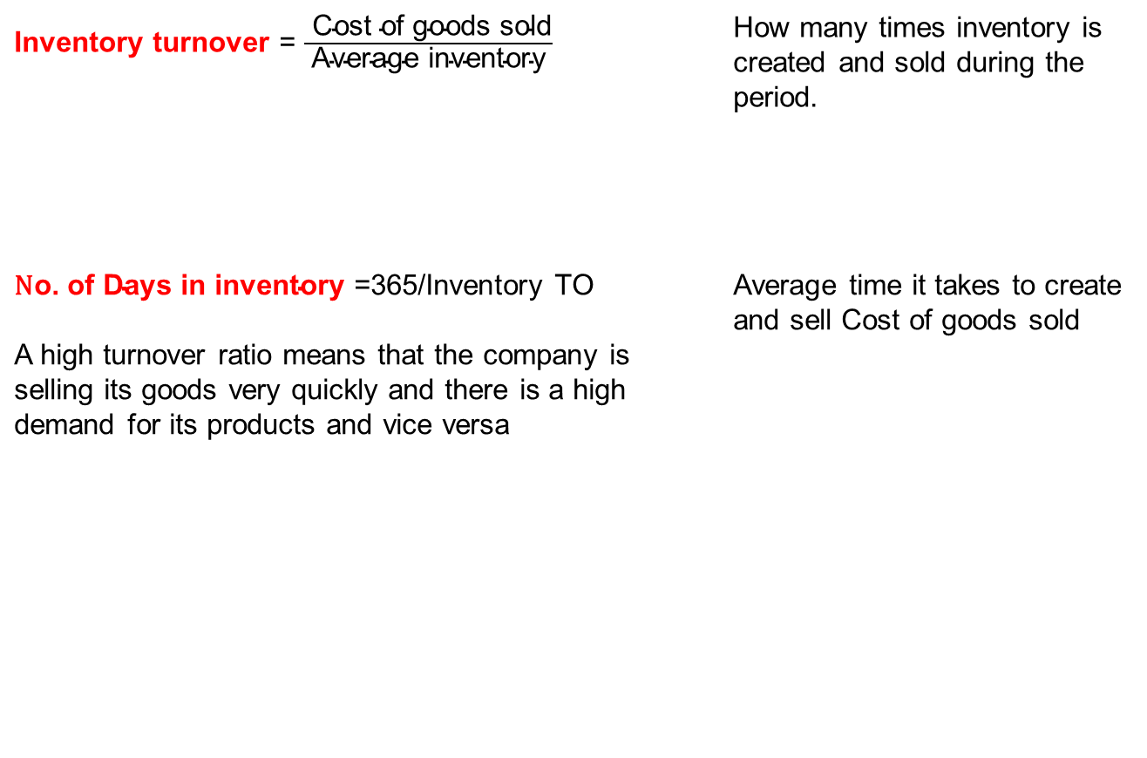
Inventory turnover Ratio
Turnover ratios reflect the number of times assets flow into and out of the company during the period.
A turnover is a measure of the efficiency of putting assets to work.
Ratios:
Inventory turnover = $\frac{ \text{Cost} \text{of} \text{goods} \text{sold}}{\text{Average} \text{inventory}}$ | How many times inventory is created and sold during the period.
$\text{N}\text{o}\text{. }\text{of} \text{Days} \text{in} \text{inventory}\text{ =}$365/Inventory TO A high turnover ratio means that the company is selling its goods very quickly and there is a high demand for its products and vice versa | Average time it takes to create and sell Cost of goods sold
Notes:
LOS: Calculate and interpret measures of a company’s operating efficiency, internal liquidity (liquidity ratios), solvency, and profitability, and demonstrate the use of these measures in company analysis.
Pages 358–360
Activity Ratios
Turnover ratios reflect the number of times assets flow into and out of the company during the period.
A turnover is a gauge of the efficiency of putting assets to work.
Inventory turnover: How many times inventory is created and sold during the period.
Receivables turnover: How many times accounts receivable are created and collected during the period.
Total asset turnover: The extent to which total assets create revenues during the period.
Working capital turnover: The efficiency of putting working capital to work.
Note: A way of looking at turnover ratios is to consider that the denominator is the investment that is being put to work and the numerator is the result of that effort.

Slide 19
Inventory Turnover Ratio
This ratio measures how quickly the company sells its inventory.
Inventory
Turnover Ratio
Cost of Goods Sold
Average Inventory
=
The Home
Depot 2017
$66,548
$12,649*
=
= 5.26 times
*($12,549 + $12,748))
2
= $12,649
An increase in this ratio is usually favorable. However, if the ratio is too high, it may be an indication that sales were lost because desired items were not in stock. A company must balance the cost of holding inventory with the potential cost of losing a sale. On average, The Home Depot’s inventory was acquired and sold to customers just over 5 times during the year.
Notes:
The inventory turnover ratio is a measure of operating efficiency.
Because a company normally realizes profit each time inventory is sold, an increase in this ratio is usually favorable. If the ratio is too high, however, it may be an indication that sales were lost because desired items were not in stock. A company must balance the cost of holding inventory with the potential cost of losing a sale.
On average, The Home Depot’s inventory was acquired and sold to customers just over 5 times during the year. The inventory turnover ratio is critical for The Home Depot because of its business strategy. It wants to be able to offer customers the right product when they need it at a price that beats the competition. The Home Depot’s effectiveness in inventory management means that the company is able to tie up less money in carrying inventory.
Turnover ratios vary significantly from one industry to the next. Companies in the food industry (grocery stores and restaurants) have high inventory turnover ratios because their inventory is subject to rapid deterioration. Companies that sell expensive merchandise (automobiles and high-fashion clothes) have much lower ratios because sales tend to be less frequent, but customers want to have a selection to choose from so companies in these industries must still carry significant inventory.

Slide 20
Inventory Turnover Ratio – Converted to Days
The inventory turnover ratio often is converted to reflect the number of days, on average, it takes a company to sell its inventory.
Average Days to Sell Inventory
Days in a Year
Inventory Turnover Ratio
=
The Home
Depot 2017
365
5.26
=
= 69.39 days
The Home Depot’s average days to sell inventory ratio implies that, on average, it takes the company just over sixty-nine days to sell its inventory.
Notes:
The inventory turnover ratio often is converted to reflect the number of days, on average, it takes a company to sell its inventory.
On average, The Home Depot’s inventory was acquired and sold to customers just over 5 times during the year. Converting this ratio to days shows that the company takes just over 69 days to sell its inventory.

Slide 21
Accounts Payable Turnover
KEY RATIO ANALYSIS
$$$
Accounts Payable Turnover =
Purchases (or COGS) / Average Accounts Payable
Measures how quickly management is paying its suppliers.
A high accounts payable ratio normally suggests that a company is paying its suppliers in a timely manner.
The ratio is more intuitive by dividing it into the number of days in a year:
Average Days to pay payables = 365 Days ÷ Accounts Payable Turnover Ratio
Notes:
Beginning inventory 1000 end of previous year (B/S) + Purchases x 3000 – ending inventory 500 end of current year (I/S) = Cost of goods sold 3500 (I/S)
The accounts payable turnover ratio measures how quickly management is paying its suppliers. A high accounts payable ratio normally suggests that a company is paying its suppliers in a timely manner. The accounts payable turnover ratio is computed as follows: Cost of Goods Sold ÷ Average Accounts Payable.
The ratio can be made more intuitive by dividing it into the number of days in a year: Average Number of Days Payables Are Outstanding = 365 Days ÷ Accounts Payable Turnover Ratio.

Slide 22
Accounts Payable Turnover
KEY RATIO ANALYSIS
$$$
Measures how quickly management is paying its suppliers.
A high accounts payable ratio normally suggests that a company is paying its suppliers in a timely manner.
A decreasing ratio could signal that the company is taking longer to pay off its suppliers and is suffering financial distress (or it might signal that the company has negotiated different payment arrangements with its suppliers)
The ratio is more intuitive by dividing it into the number of days in a year:
Average Days to pay payables = 365 Days ÷ Accounts Payable Turnover Ratio
Notes:
The accounts payable turnover ratio measures how quickly management is paying its suppliers. A high accounts payable ratio normally suggests that a company is paying its suppliers in a timely manner. The accounts payable turnover ratio is computed as follows: Cost of Goods Sold ÷ Average Accounts Payable.
The ratio can be made more intuitive by dividing it into the number of days in a year: Average Number of Days Payables Are Outstanding = 365 Days ÷ Accounts Payable Turnover Ratio.

Slide 23
Operating and Cash Cycles
The operating cycle is the number of days that inventory is held before it is sold and the number of days that accounts receivables is held before collection.
The cash conversion cycle is the operating cycle minus the average age of accounts payable.

Slide 24
Example: Assume that a company has an average age of inventory of 120 days, an average age of accounts payable of 100 days and an average age of accounts receivable of 40 days.
Calculate the operating cycle and the cash cycle.
Operating Cycle = 160 Days
120 Days Sales in Inventory
40 Days Sales in AR
Cash Conversion Cycle = 60 Days
−100 Days Purchases in Accounts Payable

Slide 25
Third: Solvency Analysis
A company’s business risk is determined, in large part, from the company’s line of business.
Financial risk is the risk resulting from a company’s choice of how to finance the business using debt or equity.
We use solvency ratios to assess a company’s financial risk.
Solvency refers to the long-run financial viability and its ability to cover long-term obligations
There are two types of solvency ratios: Capital Structure, earnings power and loan covenants.
Capital Structure: Involve evaluating elements in the capital structure and their attributes.
Earning power — recurring ability to generate cash from operations
Loan covenants — protection against insolvency and financial distress; they define default (and the legal remedies available when it occurs) to allow the opportunity to collect on a loan before severe distress
Risk
Business Risk
Financial Risk
Sales Risk
Operating Risk
Notes:
LOS: Calculate and interpret measures of a company’s operating efficiency, internal liquidity (liquidity ratios), solvency, and profitability, and demonstrate the use of these measures in company analysis.
Pages 365–369
Solvency Analysis
A company’s business risk is determined, in large part, from the company’s line of business.
Financial risk is the risk resulting from a company’s choice of how to finance the business using debt or equity.
We use solvency ratios to assess a company’s financial risk.
There are two types of solvency ratios: component percentages and coverage ratios.
Component percentages involve comparing the elements in the capital structure.
Coverage ratios measure the ability to meet interest and other fixed financing costs.

Slide 26
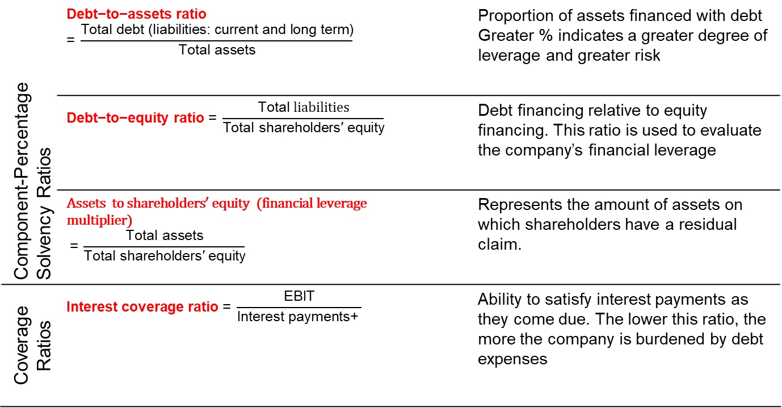
Solvency ratios
Component-Percentage Solvency Ratios | $$\text{Debt}\text{−}\text{to}\text{−}\text{assets} \text{ratio}\text{ = }\frac{\text{Total} \text{debt}\text{ (}\text{liabilities}\text{: }\text{current} \text{and} \text{long} \text{term}\text{)}}{\text{Total} \text{assets}}$$ |  | Proportion of assets financed with debt Greater % indicates a greater degree of leverage and greater risk
 | $$\text{Debt}\text{−}\text{to}\text{−}\text{equity} \text{ratio}\text{ = }\frac{\text{Total} liabilities}{\text{Total} \text{shareholders}\text{′ }\text{equity}}$$ |  | Debt financing relative to equity financing. This ratio is used to evaluate the company’s financial leverage
 | $$\text{Assets} \text{to} \text{shareholders}\text{′ }\text{equity}\text{ (}\text{financial} \text{leverage} \text{multiplier}\text{)}$$ $$\text{= }\frac{\text{Total} \text{assets}}{\text{Total} \text{shareholders}\text{′ }\text{equity}}$$ |  | Represents the amount of assets on which shareholders have a residual claim.
Coverage Ratios | $$\text{Interest} \text{coverage} \text{ratio} \text{= }\frac{\text{EBIT}}{\text{Interest} \text{payments}\text{+ }}$$ |  | Ability to satisfy interest payments as they come due. The lower this ratio, the more the company is burdened by debt expenses
Notes:
LOS: Calculate and interpret measures of a company’s operating efficiency, internal liquidity (liquidity ratios), solvency, and profitability, and demonstrate the use of these measures in company analysis.
Pages 366–368
Solvency Ratios
Component-Percentage Solvency Ratios
Debt-to-assets ratio
$$\text{Debt}\text{−}\text{to}\text{−}\text{assets} \text{ratio}\text{ = }\frac{\text{Total} \text{debt}}{\text{Total} \text{assets}}$$
Proportion of assets financed with debt.
Long-term debt-to-assets ratio
$$\text{Long}\text{−}\text{term} \text{debt}\text{−}\text{to}\text{−}\text{assets} \text{ratio}\text{ = }\frac{\text{Long}\text{−}\text{term} \text{debt}}{\text{Total} \text{assets}}$$
Proportion of assets financed with long-term debt.
Debt-to-equity ratio
$$\text{Debt}\text{−}\text{to}\text{−}\text{equity} \text{ratio}\text{ = }\frac{\text{Total} \text{debt}}{\text{Total} \text{shareholders}\text{′ }\text{equity}}$$
Debt financing relative to equity financing.
Financial leverage (also referred to as the equity multiplier)
$$\text{Financial} \text{leverage}\text{ = }\frac{\text{Total} \text{assets}}{\text{Total} \text{shareholders}\text{′ }\text{equity}}$$
Reliance on debt financing.
Coverage ratios
Interest coverage ratio
$$\text{Interest} \text{coverage} \text{ratio}\text{ = }\frac{\text{EBIT}}{\text{Interest} \text{payments}}$$
Ability to satisfy interest obligations.
Fixed charge coverage ratio
$$\begin{matrix}\text{Fixed} \text{charge} \\ \text{coverage} \text{ratio}\end{matrix}\text{ = }\frac{\text{EBIT} \text{+} \text{Lease} \text{payments}}{\text{Interest} \text{payments} \text{+} \text{Lease} \text{payments}}$$
Ability to satisfy interest and lease obligations.
Cash flow coverage ratio
$$\begin{matrix}\text{Cash} \text{flow} \\ \text{coverage} \text{ratio}\end{matrix} \text{= }\frac{\text{CFO} \text{+} \text{Interest} \text{payments} \text{+} \text{Tax} \text{payments}}{\text{Interest} \text{payments}}$$
Ability to satisfy interest obligations with cash flows.
Cash-flow-to-debt ratio
$$\begin{matrix}\text{Cash}\text{−}\text{flow}\text{−}\text{to}\text{−} \\ \text{debt} \text{ratio}\end{matrix}\text{=} \frac{\text{CFO}}{\text{Total} \text{debt}}$$
Length of time needed to pay off debt with cash flows.
Discussion question: Is it possible for a company to have solvency ratios, such as the debt-to-assets and debt-to-equity ratios, that are increasing over time, yet the coverage ratios are not increasing?

Slide 27
Debt-to-Equity Ratio
This ratio measures the amount of liabilities that exists for each $1 invested by the owners.
Debt-to-Equity Ratio
Total Liabilities
Total Stockholders’ Equity
=
The Home
Depot 2017
$43,075
$1,454
=
= 29.63
In fiscal 2017, for each $1.00 of stockholders’ equity, The Home Depot had $29.63 of liabilities.
Notes:
The debt-to-equity ratio expresses a company’s debt as a proportion of its stockholders’ equity.
In fiscal 2017, for each $1.00 of stockholders’ equity, The Home Depot had $29.63 of liabilities. The primary reason The Home Depot’s ratio is high is that The Home Depot has been repurchasing treasury stock, which lowers total stockholders’ equity. The Home Depot’s debt-to-equity ratio was 8.92 in fiscal 2016 and 5.65 in fiscal 2015.
Debt is risky for a company because specific interest payments must be made even if the company has not earned sufficient income to pay them. In contrast, dividends are always at the company’s discretion and are not legally enforceable until they are declared by the board of directors. Thus, equity capital is associated with fewer contractual payments than is debt.
Despite the risk associated with debt, however, most companies obtain significant amounts of resources from creditors because of the advantages of borrowing. For example, interest expense is a deductible expense, up to a cap, on a company’s income tax return. Weighing these benefits against the contractual obligations that accompany debt results in companies using a mix of debt and equity financing. Analysts evaluate this mix by computing the debt-to-equity ratio.

Slide 28
Times Interest Earned Ratio
This ratio compares the income available to pay interest in a period to a company’s interest obligation for the same period.
This ratio indicates a margin of protection for creditors.
Net Interest Income Tax Income Expense Expense
Interest Expense
+
+
Times Interest Earned
=
The Home
Depot 2017
$8,630 + $1,057 + $5,068 $1,057
=
= 13.96 times
A high ratio indicates a secure position for creditors. In fiscal 2017, The Home Depot generated $13.96 in income for each $1.00 of interest expense.
Notes:
Interest payments are a fixed obligation. If a company fails to make required interest payments, creditors may force it into bankruptcy. Because of the importance of meeting interest payments, analysts often compute a ratio called times interest earned.
The times interest earned ratio compares the income available to pay interest in a period to a company’s interest obligation for the same period. Interest expense and income tax expense are included in the numerator because these amounts are available to pay interest. The times interest earned ratio represents a margin of protection for creditors. In fiscal 2017, The Home Depot generated $13.96 in income for each $1.00 of interest expense, a high ratio that indicates a secure position for creditors.
Some analysts believe that the times interest earned ratio is flawed because interest expense is paid in cash, not with net income. These analysts prefer to use the cash coverage ratio.

Slide 29
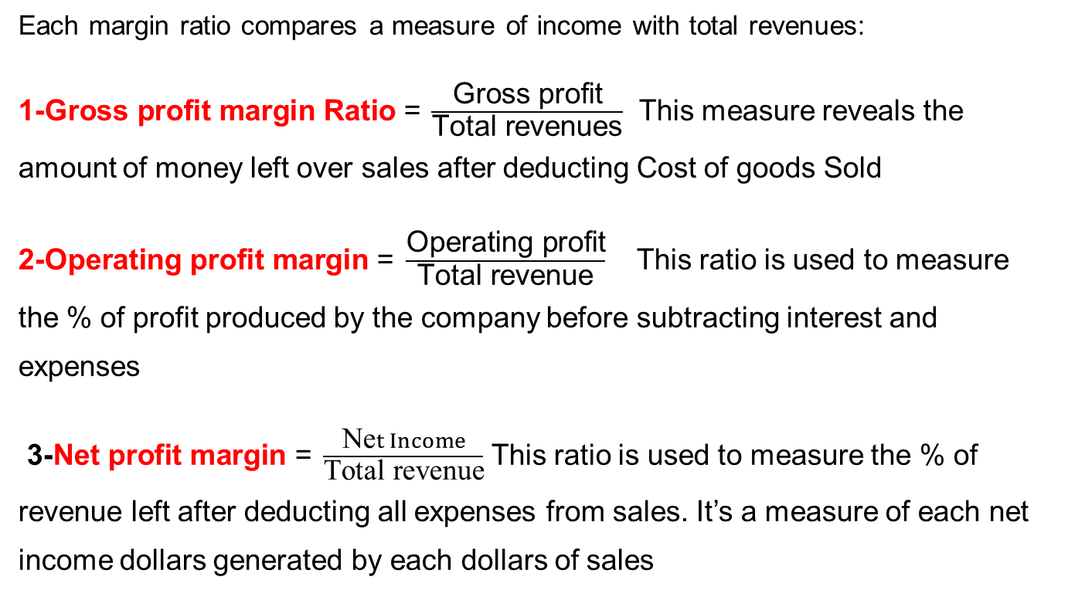
Forth: Profitability ratios
Each margin ratio compares a measure of income with total revenues:
1-$\text{Gross} \text{profit} \text{margin} \text{Ratio}\text{ =} \frac{\text{Gross} \text{profit}}{\text{Total} \text{revenues}}$ This measure reveals the amount of money left over sales after deducting Cost of goods Sold
$\text{2−}\text{Operating} \text{profit} \text{margin}\text{ = }\frac{\text{Operating} \text{profit}}{\text{Total} \text{revenue}}$ This ratio is used to measure the % of profit produced by the company before subtracting interest and expenses
$\text{3−}\text{Net} \text{profit} \text{margin}\text{ = }\frac{\text{Ne}t Income}{\text{Total} \text{revenue}}$ This ratio is used to measure the % of revenue left after deducting all expenses from sales. It’s a measure of each net income dollars generated by each dollars of sales
Notes:
LOS: Calculate and interpret measures of a company’s operating efficiency, internal liquidity (liquidity ratios), solvency, and profitability, and demonstrate the use of these measures in company analysis.
Pages 369–370
Profitability Ratios: Margins
Each margin ratio compares a measure income with total revenues:
$\text{Gross} \text{profit} \text{margin}\text{ = }\frac{\text{Gross} \text{profit}}{\text{Total} \text{revenue}}$
$\text{Operating} \text{profit} \text{margin}\text{ = }\frac{\text{Operating} \text{profit}}{\text{Total} \text{revenue}}$
$\text{Net} \text{profit} \text{margin}\text{ = }\frac{\text{Net} \text{profit}}{\text{Total} \text{revenue}}$
$\text{Pretax} \text{profit} \text{margin}\text{ = }\frac{\text{Earnings} \text{before} \text{taxes}}{\text{Total} \text{revenue}}$

Slide 30
Gross Profit Percentage
The gross profit percentage (also referred to as the gross profit margin) reflects gross profit as a percent of sales.
If not shown separately on a company’s income statement, gross profit is computed by subtracting cost of sales from net sales.
Gross Profit
Percentage
Gross Profit
Net Sales Revenue
=
The Home
Depot 2017
$34,356
$100,904
=
= 34.05%
After subtracting the direct costs associated with selling products, The Home Depot had approximately 34 cents of each dollar of sales remaining to cover other expenses.
Notes:
The gross profit percentage (also referred to as the gross profit margin) reflects gross profit as a percent of sales. If not shown separately on a company’s income statement, gross profit is computed by subtracting cost of sales from net sales.
This implies that, after subtracting the direct costs associated with selling products, The Home Depot had approximately 34 cents of each dollar of sales remaining to cover other expenses.

Slide 31
Net Profit Margin
This ratio reflects net income as a percentage of sales.
Net Profit
Margin
Net Income
Net Sales Revenue
=
The Home
Depot 2017
$8,630
$100,904
=
= 8.55%
For fiscal 2017, each dollar of The Home Depot’s sales generated over 8 cents of profit. For each dollar of sales, The Home Depot is subtracting just under 92 cents in expenses.
Notes:
For fiscal 2017, each dollar of The Home Depot’s sales generated over 8 cents of profit. For each dollar of sales, The Home Depot is subtracting just under 92 cents in expenses.
While both the gross profit percentage and the net profit margin are good measures of operating efficiency, you should be careful not to analyze them in isolation because they do not consider the resources needed to earn income. It is very difficult to compare profit margins for companies in different industries. For example, profit margins are low in the food industry while profit margins in the jewelry industry are high. Both types of businesses can be quite profitable, however, because a high sales volume can compensate for a low profit margin. Grocery stores have low profit margins, but they generate a high sales volume from a broad customer base that tends to purchase items on a daily or weekly basis. Although jewelry stores earn comparatively more profit from each sales dollar, fewer people purchase jewelry and typically do so only occasionally. Thus, jewelry stores tend to have fewer sales transactions than grocery stores.
The trade-off between profit margin and sales volume can be stated in simple terms: Would you prefer to have 5 percent of $1,000,000 or 10 percent of $100,000? As you can see, a larger profit margin is not always better in terms of total dollars earned.

Slide 32
Return on Assets (ROA)
This ratio compares income to the total assets used to generate the income .
Return on Assets
Net Income
Average Total Assets
=
The Home
Depot 2017
$8,630
$43,748*
=
= 19.73%
*($42,966 + $44,529)
2
= $43,748
On average, for every $1.00 of assets reported on The Home Depot’s balance sheet, the company earned just under 20 cents in fiscal 2017.
Notes:
Return on total assets measures how well assets have been employed by the business. To calculate this ratio, we divide net income by the average total assets for the period.
This implies that, on average, for every $1.00 of assets reported on The Home Depot’s balance sheet, the company earned just under 20 cents in fiscal 2017
Some analysts modify the basic ROA computation listed above by adding interest expense (net of tax) to the numerator of the ratio. The logic for making this adjustment is that the denominator of the ratio includes resources (assets) provided by both owners and creditors, so the numerator should include the return that was available to both groups. Interest expense is therefore added back because it was previously deducted in the computation of net income. Note, too, that when making this adjustment, interest expense often is measured net of income tax. The net of tax amount is used when interest is deductible for tax purposes, which it is up to a cap. For companies that can take advantage of this tax break, we adjust interest expense for the tax savings associated with using debt.

Slide 33

ROA can be analyzed using the DuPont Analysis
Return on Operating Assets = $\frac{ Net income}{Sales}$ X $\frac{Sales}{Average Total Assets}$
Net Profit margin X Assets turnover
Notes:
Net income X Sales
Assets Xsales

Slide 34
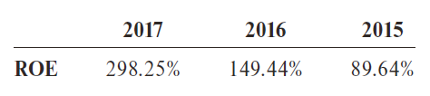
Return on Equity (ROE)
Return on Equity relates income earned to the investment made by the owners. Investors expect to earn a return on the money they invest.
Net Income
Average Stockholders’ Equity
Return on Equity
=
The Home
Depot 2017
$8,630
$2,894*
=
= 298.25%
*($4,333 + $1,454)
2
= $2,894
On average, for every $1.00 equity investors contributed to
The Home Depot, the company earned $2.98 in fiscal 2017.
Notes:
The Home Depot earned 298.25 percent on the owners’ investment. Another way to interpret this number is to say that, on average, for every $1.00 equity investors contributed to The Home Depot, the company earned $2.98 in fiscal 2017. Was this return good or bad? To answer this question, we need to compare 298.25 percent to what The Home Depot’s ROE was in prior years, or to its competitors’ ROE in 2017. The comparison with previous years indicates consistent improvement in The Home Depot’s performance as measured by its Return on Equity.

Slide 35
The DuPont Model
FINANCIAL ANALYSIS
$$$
The DuPont model is used by analysts to better assess how a company is implementing its business strategy. The model is broken down into three components:
ROE
Net Profit
Margin
Total Asset
Turnover
Financial
Leverage
Muliplier
= × ×
Net Sales
Revenue
Average Total
Assets
Net Income
Average Total Stockholders’
Equity
Net Income
Net Sales Revenue
Average Total Assets
Average Total Stockholders’
Equity
= × ×
Notes:
The DuPont model is a useful way to analyze a company’s performance. Understanding it will also help you start making connections among other ratios. For example, multiplying just the net profit margin and the total asset turnover ratio creates a company’s ROA ratio.

Slide 36
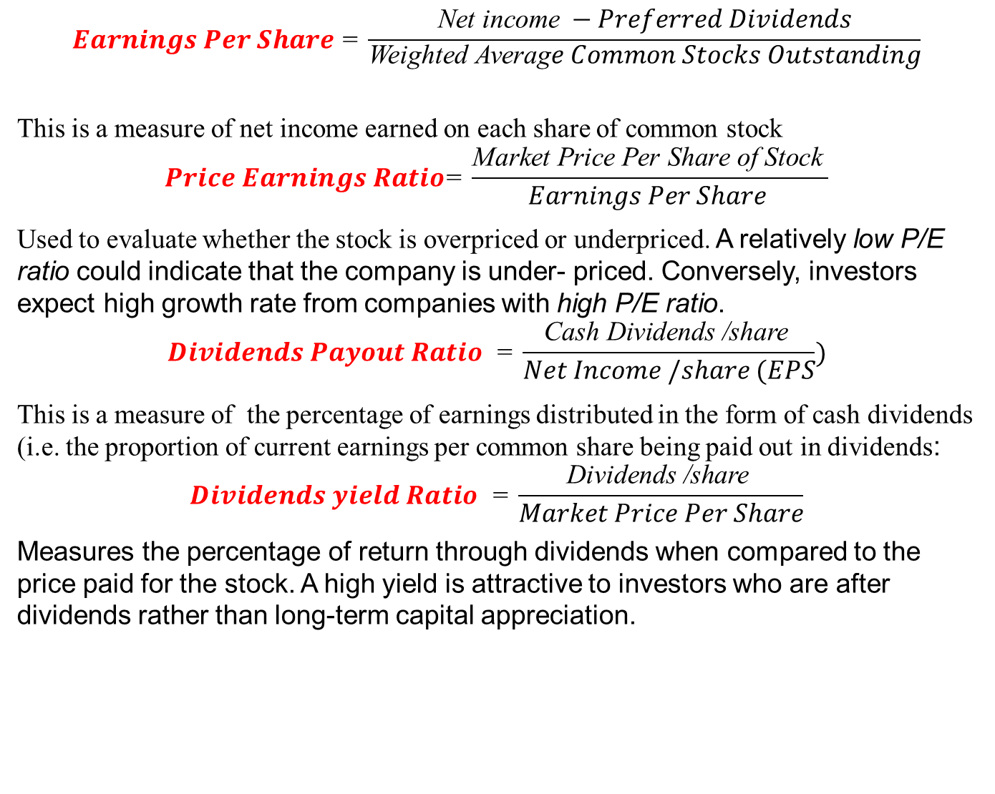
Fifth: Investor and Markets ANALYSIS)
$$Earnings Per Share \text{=} \frac{\text{Net} \text{income} −Preferred Dividends}{\begin{aligned}\text{Weighted} \text{Averag}e Common Stocks Outstanding \\ \end{aligned}}$$
This is a measure of net income earned on each share of common stock
$$Price Earnings Ratio\text{=} \frac{\text{Market} \text{Price} \text{Per} \text{Share} \text{of} \text{Stock} }{Earnings Per Share }$$
Used to evaluate whether the stock is overpriced or underpriced. A relatively low P/E ratio could indicate that the company is under- priced. Conversely, investors expect high growth rate from companies with high P/E ratio.
$$Dividends Payout Ratio \text{ =} \frac{\text{Cash} \text{Dividends}\text{ /}\text{share} }{Net Income /share (EPS})$$
This is a measure of the percentage of earnings distributed in the form of cash dividends (i.e. the proportion of current earnings per common share being paid out in dividends:
$$Dividends yield Ratio \text{ =} \frac{\text{Dividends}\text{ /}\text{share} }{Market Price Per Share}$$
Measures the percentage of return through dividends when compared to the price paid for the stock. A high yield is attractive to investors who are after dividends rather than long-term capital appreciation.

Slide 37
Earnings per Share (EPS)
The earnings per share ratio is a measure of return on investment that is based on the number of common shares outstanding.
Net Income
Weighted Average Number of Shares Outstanding
EPS =
The Home
Depot 2017
$8,630
1,178
=
=
= $7.33
Average number of shares outstanding is reported on the
bottom of the income statement
Earnings per share is probably the single most widely reported financial ratio, and it is the only ratio required by GAAP
Notes:
The earnings per share ratio is a measure of return on investment that is based on the number of common shares outstanding. You often can obtain the weighted average number of shares outstanding from the bottom of a company’s income statement (see Exhibit 13.1). Earnings per share is probably the single most widely reported ratio, and it is the only ratio required by GAAP. Analysts develop their own estimates of future EPS and the stock price of a company may change significantly if the actual EPS differs from their estimate.

Slide 38
Price/Earnings (P/E) Ratio
This ratio measures the relationship between the current market price of a company’s stock and its earnings per share.
Current Market Price per Share Earnings per Share
P/E Ratio =
The Home
Depot 2017
$207.23*
$7.33
=
= 28.27
* At the end of fiscal 2017, The Home Depot’s stock was trading at $207.23 per share.
The P/E ratio reflects the stock market’s assessment of a company’s future performance. A high ratio indicates that earnings are expected to grow rapidly.
The P/E ratio for The Home Depot indicates that the market expects them to perform well in the future. This P/E ratio indicates that The Home Depot’s stock was selling at a price that was just over 28 times its earnings per share.
Notes:
The price/earnings ratio measures the relationship between the current market price of the stock and its earnings per share. Once we know the earnings per share of stock, we can calculate the price/earnings ratio by dividing the current market price per share of the company’s stock by the earnings per share.
At the end of fiscal 2017, The Home Depot’s stock was trading at $207.23 per share. EPS for fiscal 2017 was $7.33. This P/E ratio indicates that The Home Depot’s stock was selling at a price that was just over 28 times its earnings per share. The P/E ratio reflects the stock market’s assessment of a company’s future performance. A high ratio indicates that earnings are expected to grow rapidly. The P/E ratios for The Home Depot indicates that the market expects them to perform well in the future.
In economic terms, the value of a stock is determined by calculating the present value of the company’s future earnings. Thus, a company that expects to increase its earnings in the future is worth more than one that cannot grow its earnings (assuming other factors are the same). However, while a high P/E ratio and good growth prospects are considered favorable, there are risks. When a company with a high P/E ratio does not meet the level of earnings expected by the market, the negative impact on its stock can be dramatic.

Slide 39
Dividend Yield Ratio
This ratio reflects the return on investment solely due to the dividends a company pays.
Dividend
Yield Ratio
Dividends per Share
Market Price per Share
=
The Home
Depot 2017
=
$3.56 $207.23
= 1.72%
Investors are willing to accept low dividend yields if they expect that the price of a stock will increase while they own it. Stocks with high dividend yields often appeal to retired investors who need current income rather than future growth potential.
Notes:
When investors buy stock, they can earn a return on their investment through dividends or price appreciation. The dividend yield ratio reflects the return on investment absent any capital appreciation, or, said differently, the return attributed solely to the dividends a company pays. Not all companies report the cash dividend they paid per share on their statement of cash flows or statement of stockholders’ equity, so you may need to search their 10-K to find the information. The Home Depot paid dividends of $3.56 per share in fiscal 2017. At the end of fiscal 2017, its stock price was $207.23 per share.
In recent years, the dividend yield for The Home Depot has been 2 percent or less. The dividend yield for most stocks is not high compared to alternative investments. Investors are willing to accept low dividend yields if they expect that the price of a stock will increase while they own it. Investors who bought The Home Depot stock did so knowing they would receive a dividend, but they also were expecting its stock price to increase. In contrast, stocks with low growth potential tend to offer much higher dividend yields than do stocks with high growth potential. Stocks with high dividend yields often appeal to retired investors who need current income rather than future growth potential.

Slide 40
Quality of Income
Quality of Income
Cash Flows from Operating Activities
Net Income
=
CASH FLOWS FROM OPERATING ACTIVITIES:
Net Earnings
Reconciliation of Net Earnings to Net Cash
Provided by Operating Activities:
Depreciation and Amortization
Stock-Based Compensation Expense
Changes in Assets and Liabilities, net of the effects of acquisitions:
Receivables, net
Merchandise Inventories
Other Current Assets
Accounts Payable and Accrued Expenses
Deferred Revenue
Income Taxes Payable
Deferred Income Taxes
Other
Net Cash Provided by Operating Activities
$8,630
2,062
273
139
(84)
(10)
352
128
29
92
420
12,031
The Home Depot 2017:
$12,031
$8,630
= 1.39
A ratio higher than 1 indicates high-quality income because each dollar of income is supported by one or more dollars of cash flows.
Notes:
Most financial analysts are concerned about the quality of a company’s income because some accounting procedures can be used to report higher income. For example, a company that uses LIFO and short estimated lives for depreciable assets will report lower income than an identical company that uses FIFO and longer estimated lives. One method of evaluating the quality of a company’s income is to compare its reported income to its cash flows from operating activities.
A general rule of thumb is that a quality of income ratio that is higher than 1 indicates high-quality income because each dollar of income is supported by one or more dollars of cash flows. A ratio that is below 1 represents lower-quality income.

